Slide 1
Software Quality Assurance
/
Software Quality Engineering
Lecture 9
Naseer Ahmed

Slide 2
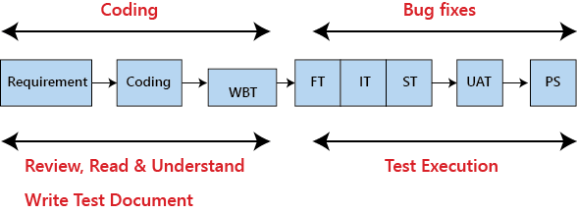
Testing Documentation
Testing documentation is the documentation of artifacts that are created during or before the testing of a software application. Documentation reflects the importance of processes for the customer, individual and organization.
Projects which contain all documents have a high level of maturity. Careful documentation can save the time, efforts and wealth of the organization.

Slide 3
Testing Documentation
There is the necessary reference document, which is prepared by every test engineer before stating the test execution process. Generally, we write the test document whenever the developers are busy in writing the code.
Once the test document is ready, the entire test execution process depends on the test document. The primary objective for writing a test document is to decrease or eliminate the doubts related to the testing activities.

Slide 4
Testing Documentation
Types of test document:
In software testing, we have various types of test document, which are as follows:
Test scenarios
Test case
Test plan
Requirement traceability matrix(RTM)
Test strategy
Test data
Bug report
Test execution report

Slide 5
Testing Documentation
Types of test document:
Test scenarios:
The test scenario is a detailed document of test cases that cover end to end functionality of a software application in liner statements. The liner statement is considered as a scenario. The test scenario is a high-level classification of testable requirements. These requirements are grouped on the basis of the functionality of a module and obtained from the use cases.
In the test scenario, there is a detailed testing process due to many associated test cases. Before performing the test scenario, the tester has to consider the test cases for each scenario.

Slide 6
Testing Documentation
Types of test document:
Test scenarios:
In the test scenario, testers need to put themselves in the place of the user because they test the software application under the user's point of view. Preparation of scenarios is the most critical part, and it is necessary to seek advice or help from customers, stakeholders or developers to prepare the scenario.

Slide 7
Testing Documentation
Types of test document: Test scenarios:
How to write Test Scenarios
As a tester, follow the following steps to create Test Scenarios-
Read the requirement document such as BRS (Business Requirement Specification), SRS (System Requirement Specification) and FRS (Functional Requirement Specification) of the software which is under the test.
Determine all technical aspects and objectives for each requirement.
Find all the possible ways by which the user can operate the software.
Ascertain all the possible scenario due to which system can be misused and also detect the users who can be hackers.

Slide 8
Testing Documentation
Types of test document: Test scenarios:
How to write Test Scenarios
After reading the requirement document and completion of the scheduled analysis make a list of various test scenarios to verify each function of the software.
Once you listed all the possible test scenarios, create a traceability matrix to find out whether each and every requirement has a corresponding test scenario or not.
Supervisor of the project reviews all scenarios. Later, they are evaluated by other stakeholders of the project.

Slide 9
Testing Documentation
Types of test document: Test scenarios:
Features of Test Scenario
The test scenario is a liner statement that guides testers for the testing sequence.
Test scenario reduces the complexity and repetition of the product.
Test scenario means talking and thinking about tests in detail but write them in liner statements.
It is a thread of operations.
Test scenario becomes more important when the tester does not have enough time to write test cases, and team members agree with a detailed liner scenario.
The test scenario is a time saver activity.
It provides easy maintenance because the addition and modification of test scenarios are easy and independent..

Slide 10
Testing Documentation
Types of test document: Test scenarios:
Test scenarios on the Login module
Enter the valid login details (Username, password), and check that the home page is displayed.
Enter the invalid Username and password and check for the home page.
Leave Username and password blank, and check for the error message displayed.
Enter the valid Login, and click on the cancel, and check for the fields reset.
Enter invalid Login, more than three times, and check that account blocked.
Enter valid Login, and check that the Username is displayed on the home screen.

Slide 11
Testing Documentation
Types of test document: Test scenarios:
Test scenarios on Compose module
Checks that all users can enter email ides in the To, Cc, and Bcc.
Check that the entire user can enter various email ids in To, Cc, and Bcc.
Compose a mail, send it, and check for the confirmation message.
Compose a mail, send it, and check in the sent item of the sender and the inbox.
Compose a mail, send it, and check for invalid and valid email id (valid format), check the mail in sender inbox.
Compose main, discard, and then check for conformation message and check-in draft.
Compose mail click on save as draft and check for the confirmation message
Compose mail click on close and check for conformation save as drafts.

Slide 12
Testing Documentation
Types of test document: Test scenarios:
Test scenarios on Compose module
Checks that all users can enter email ides in the To, Cc, and Bcc.
Check that the entire user can enter various email ids in To, Cc, and Bcc.
Compose a mail, send it, and check for the confirmation message.
Compose a mail, send it, and check in the sent item of the sender and the inbox.
Compose a mail, send it, and check for invalid and valid email id (valid format), check the mail in sender inbox.
Compose main, discard, and then check for conformation message and check-in draft.
Compose mail click on save as draft and check for the confirmation message
Compose mail click on close and check for conformation save as drafts.

Slide 13
Testing Documentation
Types of test document: Test scenarios:
Test scenarios on Inbox module
Click on the inbox, and verify all received mail are displayed and highlighted in the inbox.
Check that a latest received mail has been displayed to the sender email id correctly.
Select the mail, reply and forward send it; check in the sent item of sender and inbox of the receiver.
Check for any attached attachments to the mail that are downloaded or not.
Check that attachment is scanned correctly for any viruses before download.
Select the mail, reply and forward save as draft, and check for the confirmation message and checks in the Draft section.

Slide 14
Testing Documentation
Types of test document: Test scenarios:
Test scenarios on Inbox module
Check all the emails are marked as read are not highlighted.
Check all mail recipients in Cc are visible to all users.
Checks all email recipients in Bcc are not visible to the users.
Select mail, delete it, and then check in the Trash section.
Test scenario on Trash module
Open trash, check all deleted mail present.
Restore mail from Trash; check-in the corresponding module.
Select mail from trash, delete it, and check mail is permanently deleted.

Slide 15
Testing Documentation
Types of test document:
Test case:
The test case is defined as a group of conditions under which a tester determines whether a software application is working as per the customer's requirements or not. Test case designing includes preconditions, case name, input conditions, and expected result. A test case is a first level action and derived from test scenarios.
It is an in-details document that contains all possible inputs (positive as well as negative) and the navigation steps, which are used for the test execution process. Writing of test cases is a one-time attempt that can be used in the future at the time of regression testing.

Slide 16
Testing Documentation
Types of test document:
Test case:
Test case gives detailed information about testing strategy, testing process, preconditions, and expected output. These are executed during the testing process to check whether the software application is performing the task for that it was developed or not.
Test case helps the tester in defect reporting by linking defect with test case ID. Detailed test case documentation works as a full proof guard for the testing team because if developer missed something, then it can be caught during execution of these full-proof test cases.

Slide 17
Testing Documentation
Types of test document:
Test case:
To write the test case, we must have the requirements to derive the inputs, and the test scenarios must be written so that we do not miss out on any features for testing. Then we should have the test case template to maintain the uniformity, or every test engineer follows the same approach to prepare the test document.
Generally, we will write the test case whenever the developer is busy in writing the code.

Slide 18
Testing Documentation
Types of test document: Test case:
When do we write a test case?
We will write the test case when we get the following:
When the customer gives the business needs then, the developer starts developing and says that they need 3.5 months to build this product.
And In the meantime, the testing team will start writing the test cases.
Once it is done, it will send it to the Test Lead for the review process.
And when the developers finish developing the product, it is handed over to the testing team.
The test engineers never look at the requirement while testing the product document because testing is constant and does not depends on the mood of the person rather than the quality of the test engineer.

Slide 19
Testing Documentation
Types of test document: Test case:
When do we write a test case?
We will write the test case when we get the following:
When the customer gives the business needs then, the developer starts developing and says that they need 3.5 months to build this product.
And In the meantime, the testing team will start writing the test cases.
Once it is done, it will send it to the Test Lead for the review process.
And when the developers finish developing the product, it is handed over to the testing team.
The test engineers never look at the requirement while testing the product document because testing is constant and does not depends on the mood of the person rather than the quality of the test engineer.

Slide 20
Testing Documentation
Types of test document: Test case:
Why we write the test cases?
We will write the test for the following reasons:
To require consistency in the test case execution
To make sure a better test coverage
It depends on the process rather than on a person
To avoid training for every new test engineer on the product
To require consistency in the test case execution: we will see the test case and start testing the application.
The primary purpose of writing a test case is to achieve the efficiency of the application.

Slide 21
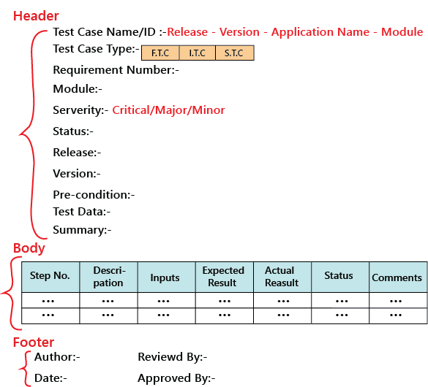
Testing Documentation
Types of test document: Test case:
Test case template

Slide 22
Testing Documentation
Types of test document: Test case:
Test case template
The template we discuss is not the standard one because it can be different for each company and also with each application, which is based on the test engineer and the test lead. But, for testing one application, all the test engineers should follow a usual template, which is formulated.
The test case should be written in simple language so that a new test engineer can also understand and execute the same.

Slide 23
Testing Documentation
Types of test document: Test case:
Test case template
In the sample template, the header contains the following:
Step number
It is also essential because if step number 20 is failing, we can document the bug report and hence prioritize working and also decide if it’s a critical bug.
Test case type
It can be functional, integration or system test cases or positive or negative or positive and negative test cases.
Release
One release can contain many versions of the release.

Slide 24
Testing Documentation
Types of test document: Test case:
Test case template
Pre-condition
These are the necessary conditions that need to be satisfied by every test engineer before starting the test execution process. Or it is the data configuration or the data setup that needs to be created for the testing.
For example: In an application, we are writing test cases to add users, edit users, and delete users. The per-condition will be seen if user A is added before editing it and removing it.

Slide 25
Testing Documentation
Types of test document: Test case:
Test case template
Test data
These are the values or the input we need to create as per the per-condition.
For example, Username, Password, and account number of the users.
The test lead may be given the test data like username or password to test the application, or the test engineer may themself generate the username and password.

Slide 26
Testing Documentation
Types of test document: Test case:
Test case template
Severity
The severity can be major, minor, and critical, the severity in the test case talks about the importance of that particular test cases. All the text execution process always depends on the severity of the test cases.
We can choose the severity based on the module. There are many features include in a module, even if one element is critical, we claim that test case to be critical. It depends on the functions for which we are writing the test case.
For example, we will take the Gmail application and let us see the severity based on the modules:

Slide 27
Testing Documentation
Types of test document: Test case:
Test case template
Severity
Modules Severity
Login Critical
Help Minor
Compose mail Critical
Setting Minor
Inbox Critical
Sent items Major
Logout Critical

Slide 28
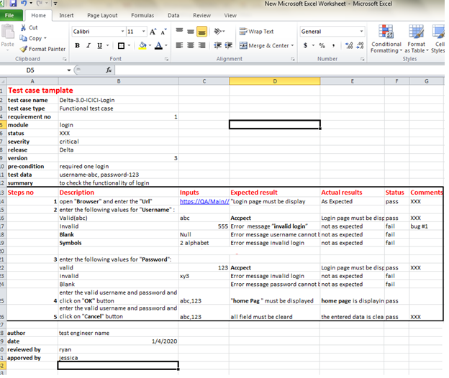
Testing Documentation
Types of test document: Test case:
Test case template
Example of a test case template

Slide 29
Testing Documentation
Types of test document: Test case:
Best Practice for writing good Test Case Example.
Test Cases need to be simple and transparent
Create Test Case with End User in Mind
Avoid test case repetition.
Do not Assume
Ensure 100% Coverage
Test Cases must be identifiable.
Implement Testing Techniques
Self-cleaning
Repeatable and self-standing
Peer Review.

Slide 30
Testing Documentation
Types of test document: Test case:
Test case review process
When the test engineer writes a test case, he/she may skip some scenarios, inputs and writes wrong navigation steps, which may affect the entire test execution process.
To avoid this, we will do one round of review and approval process before starting test execution.
If we don't go for the review process, we miss out some scenarios, accuracy won't be there, and the test engineer won't be serious.
All the cases need to be sent for the review process only after the completion of writing the test case. So, the other person does not get disturbed.

Slide 31
Testing Documentation
Types of test document: Test case:
Test case review process
Once the author finishes writing the test case, it needs to be sent for the other test engineer known as a reviewer for the review process.
The reviewer opens the test case with the corresponding requirement and checks the correctness of the test case, proper flow, and maximum test coverage.
During this review process, if the reviewer found any mistake, he/she writes it in a separate document, which is known as Review document and sends it back to the author.
The author goes through all the review comments and starts doing the changes if it is necessary, then send it back once again for the review process.

Slide 32
Testing Documentation
Types of test document: Test case:
Test case review process
This correction process will continue until both authors, and the reviewer will satisfy.
Once the review is successful, the reviewer sends it back to the test lead for the final approval process.
During this approval process, the Team leads are always kept in the loop so that the author and reviewer will be serious in their jobs.
When the test cases are written, review, and approved, it will be stored in one centralized location, which is known as Test Case Repository.

Slide 33
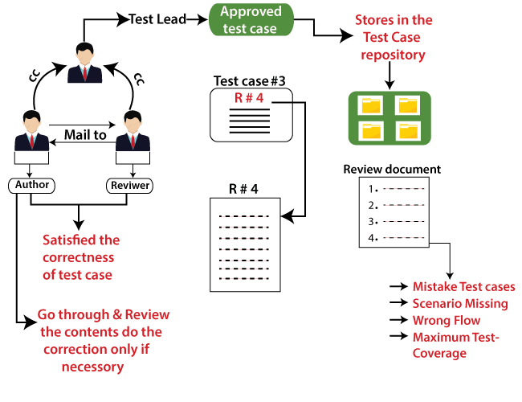
Testing Documentation
Types of test document: Test case:
Test case review process

Slide 34
Testing Documentation
Types of test document: Test case:
Test case review process
While reviewing, the reviewer checks the following aspect in the test cases:
Template
The reviewer checks whether the template is as per requirements for the product or not.
Header
All the attributes are captured or not.
All the attributes are relevant or not.
All the attributes are filled or not.

Slide 35
Testing Documentation
Types of test document: Test case:
Test case review process
Body
The test case should be prepared so that it should take minimum time for the execution process.
All the possible scenarios are covered or not.
Look for the flow including maximum test Coverage
The test case design technique is applied or not.
The test case should be simple to understand
Proper navigation is written or not.

Slide 36
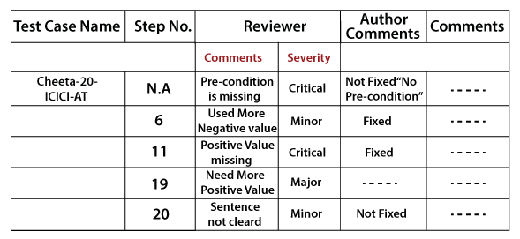
Testing Documentation
Types of test document: Test case:
Test case review process
Once the test case is reviewed, the review comments will be sent to the test case review template.

Slide 37
Testing Documentation
Types of test document: Test case:
Test case review process
Once the test case is reviewed, the review comments will be sent to the test case review template.

Slide 38
Testing Documentation
Types of test document: Test case:
Test case review process
Text Execution Report
It is the final document, which is prepared by a test lead when the entire testing process is completed.
The test execution report defined the stability of the application and contained the information like the number of cases written, executed, pass, fail, and their percentage.
The test execution report is a final summary report based on which the quality of the application is defined, and it also helps in deciding that the application can be handed over to the customer or not.
Every module has a separate spreadsheet of their respective module.

Slide 39
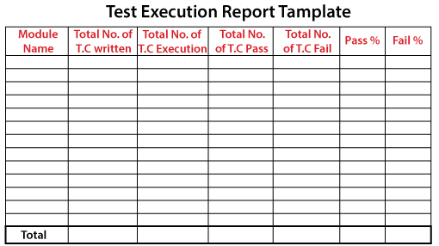
Testing Documentation
Types of test document: Test case:
Test case review process
Text Execution Report

Slide 40
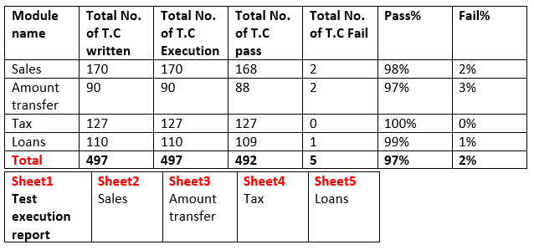
Testing Documentation
Types of test document: Test case:
Test case review process
Text Execution Report

